Slide 1
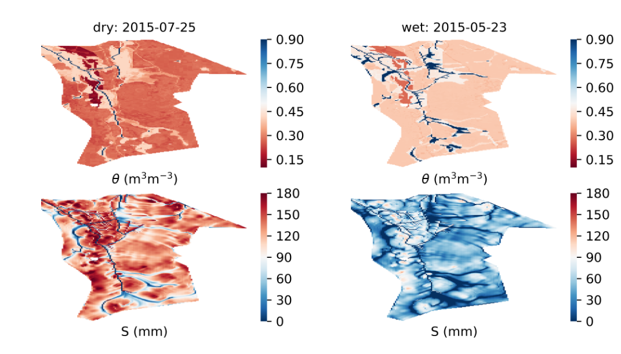
Evapotranspiration in boreal forest catchments: upscaling by process models and open GIS data
Samuli Launiainen, Aura Salmivaara, Antti-Jussi Kieloaho, Mikko Peltoniemi, and Mingfu Guan

Slide 2
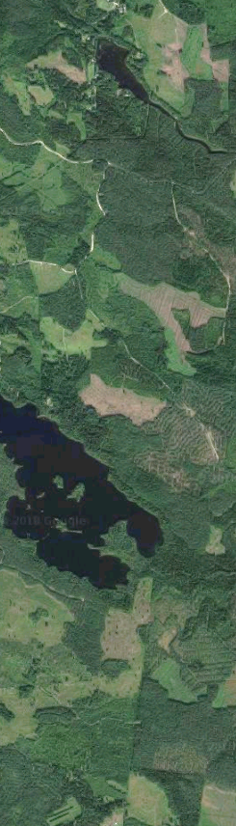
Background
Boreal mixed coniferous forests cover ~80% of land area in Finland
Forest management creates mosaic landscape
Why actual ET and its spatial variability?
Soil moisture & biogeochemical cycles, growth and climate feedback
Improved description of ET will reduce uncertainties in catchment models
Objectives:
Develop generic daily stand-level ET model
validate against eddy-covariance data
Upscale to landscape scale using open data
evaluate using annual ET from catchment water balance
”Simple, applicable at large scale, minimal calibration”

Slide 3
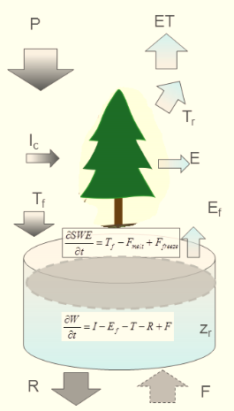
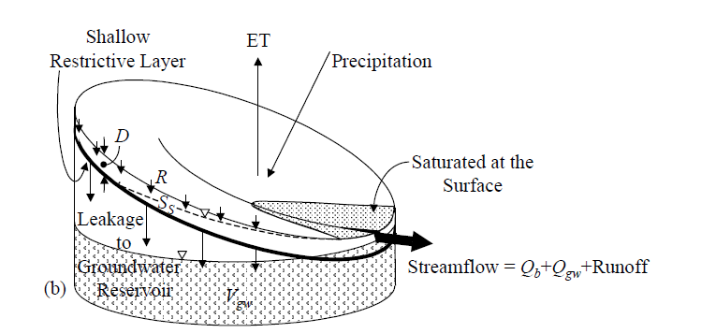
Semi-distributed catchment model
Catchment → (n x m) grid of buckets
INPUT 2D-GRIDS:
Conifer & deciduous LAI, tree height
Soil map, root zone organic layer depths
Catchment boundaries
Topografic wetness index TWI
DAILY FORCING
Precip, SW radiation, temperature, RH (or VPD), wind speed
DAILY GRID-OUTPUTS:
ET & components
Snow water equivalent
Organic layer & root zone moisture
Drainage from root zone
Saturation deficit (→ proxy of water table)
Returnflow & dynamics of saturated area
CATCHMENT OUTLET
Streamflow
...
+ TOPMODEL for streamflow
generation & returnflow
Launiainen et al. 2018, in prep.

Slide 4

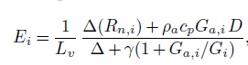
P
ET
Three-source Penman-Monteith
Evaporation (sublimation) of canopy intercepted rain (snow)
Canopy transpiration
Evaporation from ground
Temperature-index snow model
Two-layer bucket model
Organic layer
Root zone

Slide 5
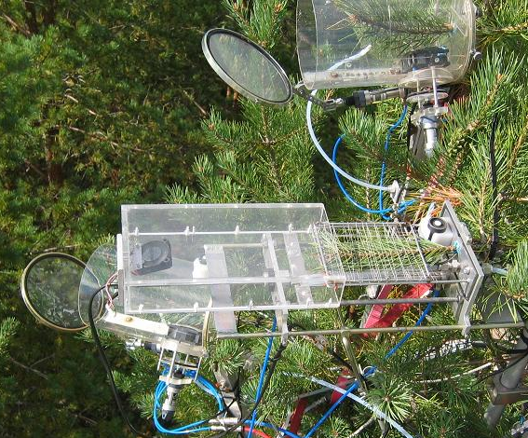
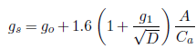
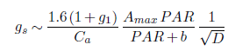
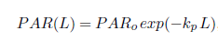
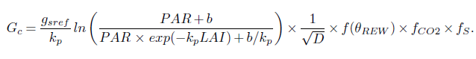
Leaf to canopy stomatal conductance
Medlyn et al. 2011
’USO’
A net photosynthesis
g₁ depends on water use strategy
g_{sref} light-saturated stomatal conductance at D = 1 kPa & const C_{a}
Scots pine: g_{sref} ~2.5 mm/s (2.2 – 2.8), b ~30 – 50 Wm⁻²
Birch, aspen ~4.0 – 4.5 mm/s
k_{p} ~0.6
scale-analysis & hyperbolic light-response
g_{sref}
Exponential PAR within canopy
plant traits
Leaf → canopy
soil moisture
atm. CO2
phenology
Medlyn et al, 2011.
Global Change Biol. 17, 2134-2144

Slide 6
Parameterization
Mainly from literature
Some parameters calibrated
a single flux site, Hyytiälä, Southern Finland
1 for ground evaporation:
multi-layer SVAT –model APES
sub-canopy EC data
1 for transpiration
g_{sref} from leaf gas exchange
check against EC data
1 for interception of rainfall:
capacity = w x LAI, using throughfall data
APES: Launiainen et al. 2015 Ecol. Mod

Slide 7
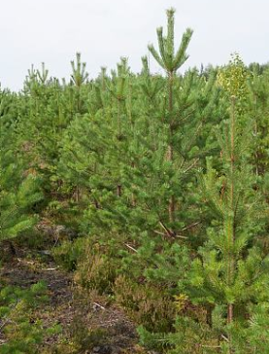
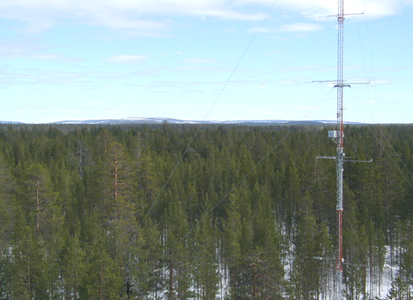
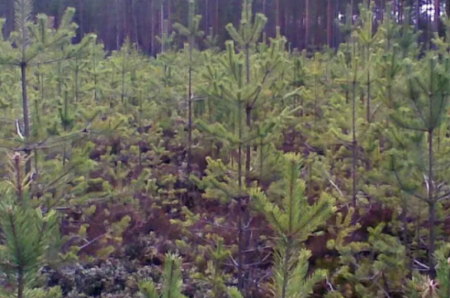
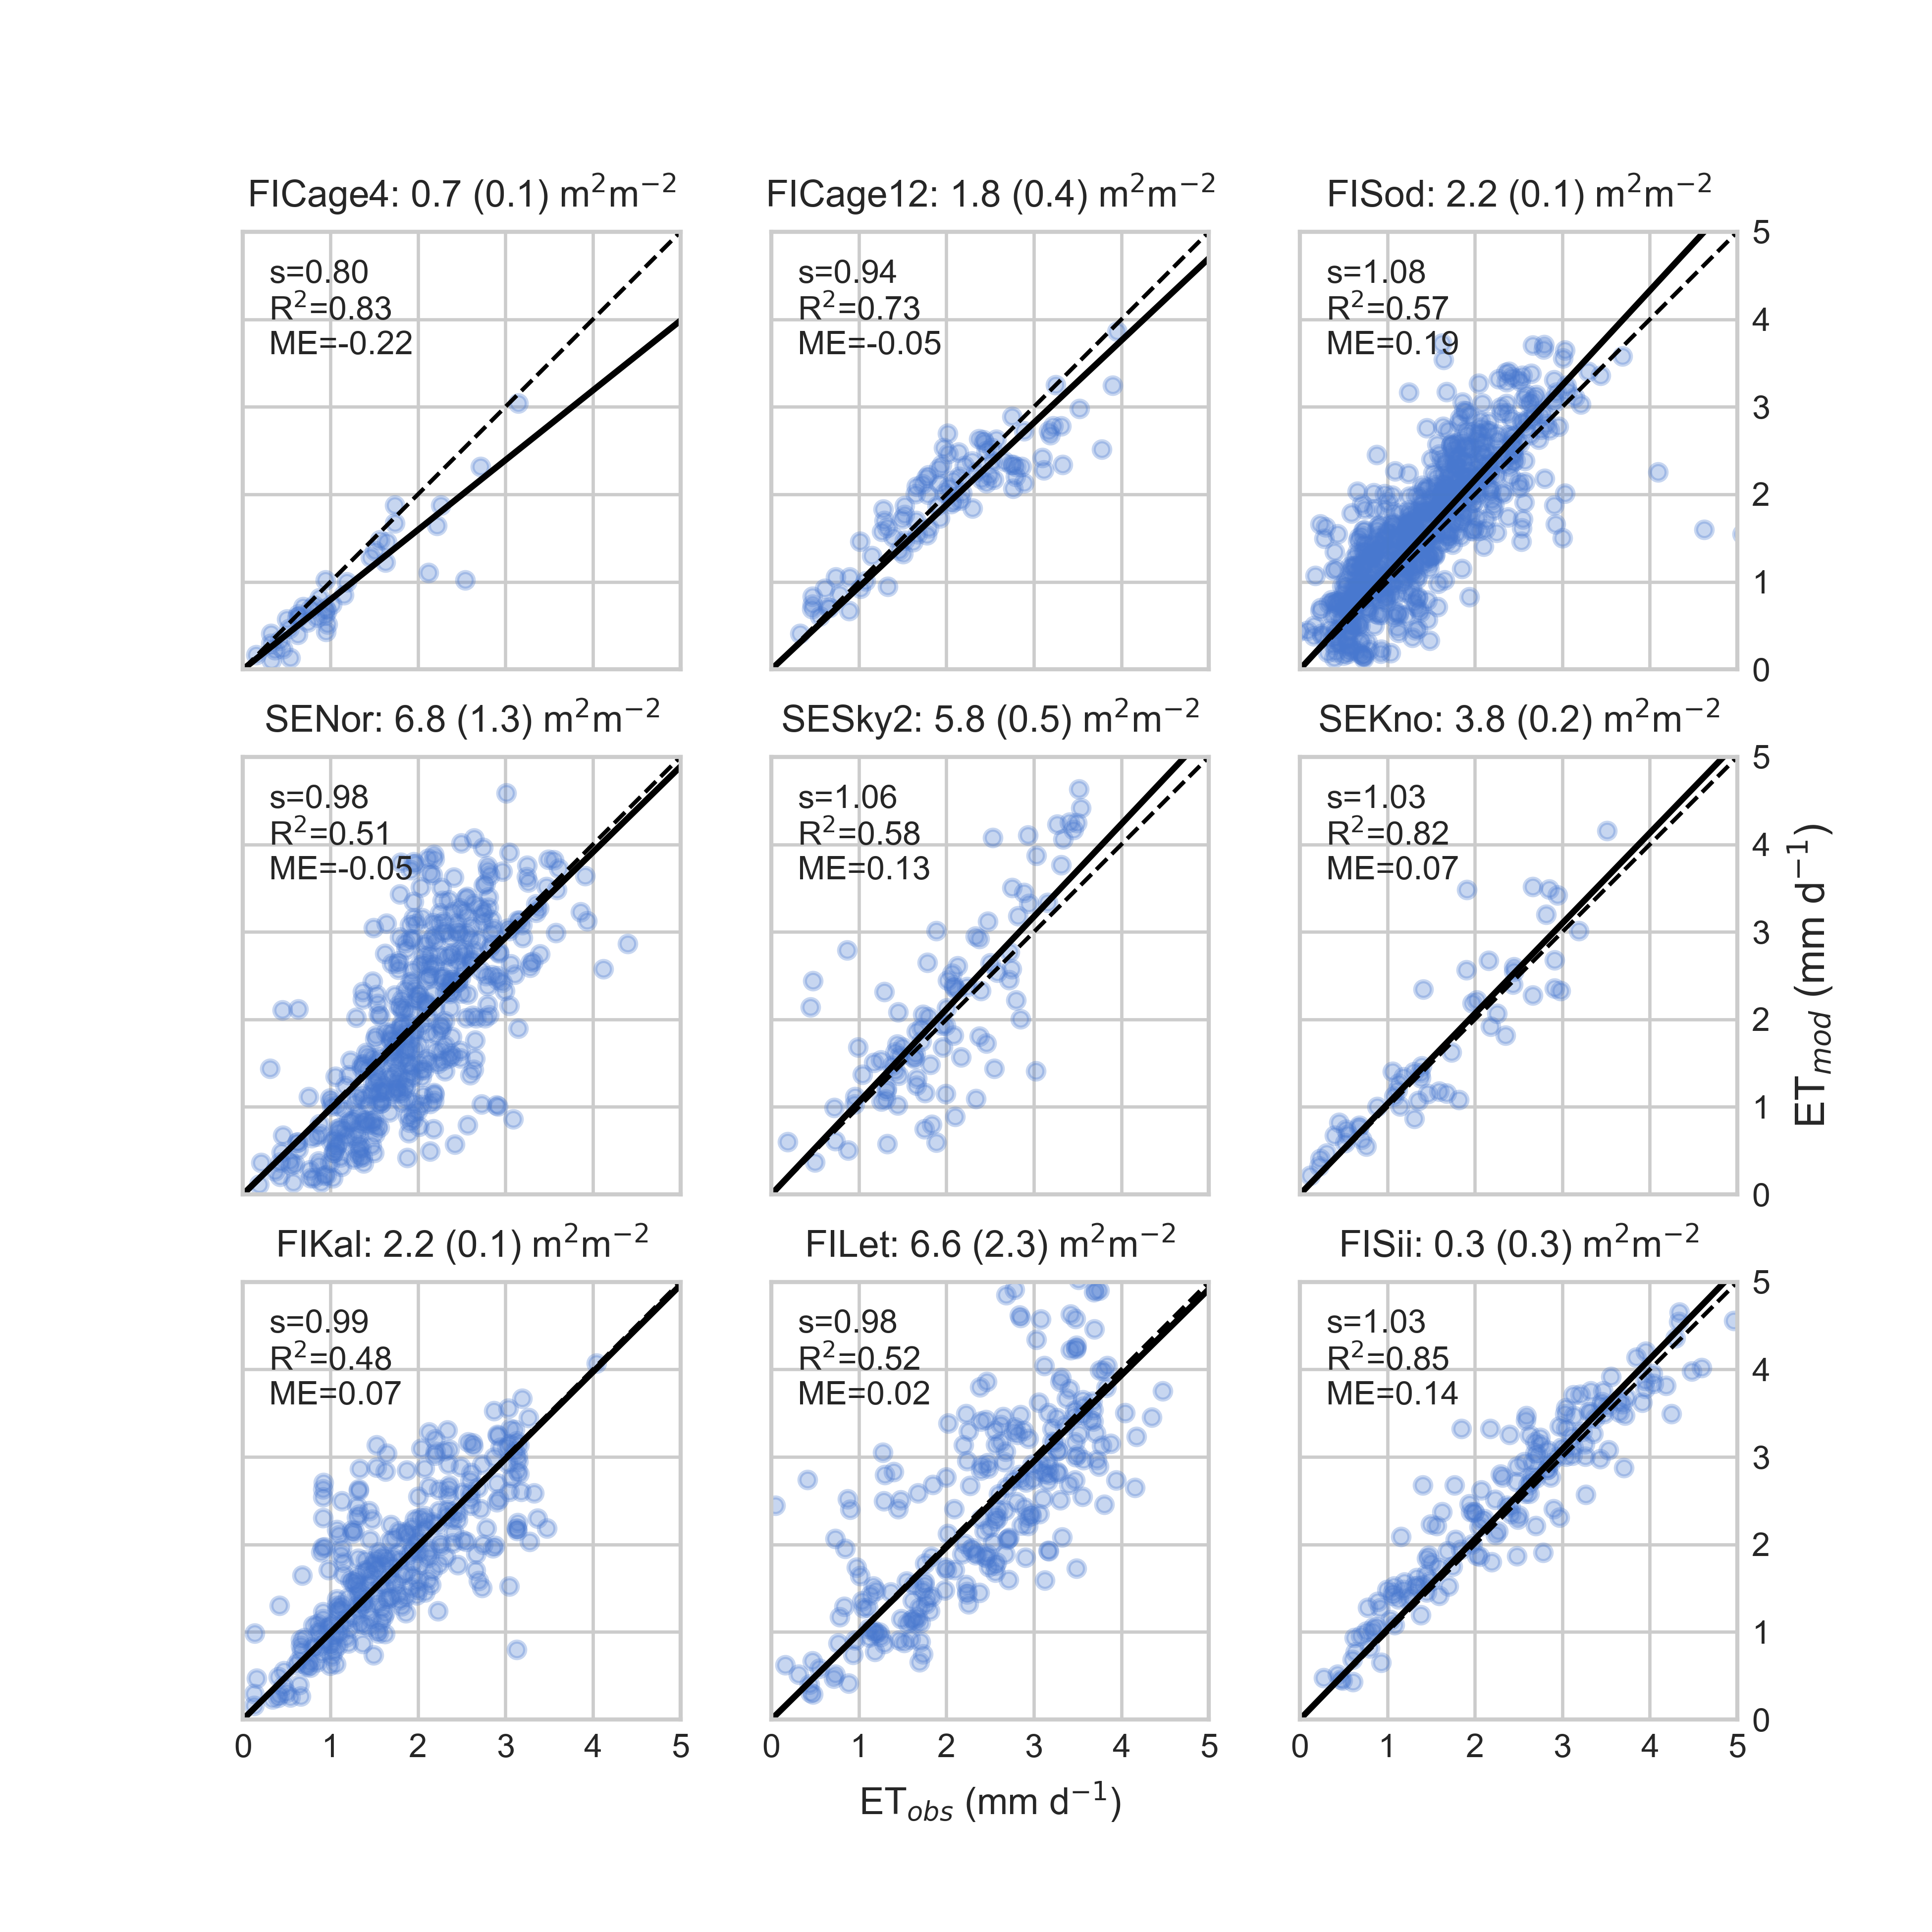
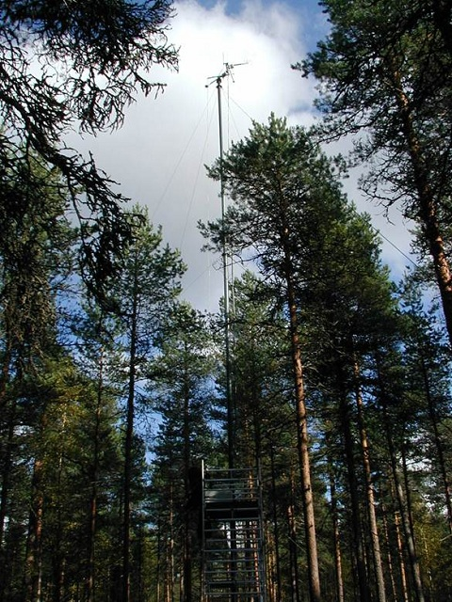
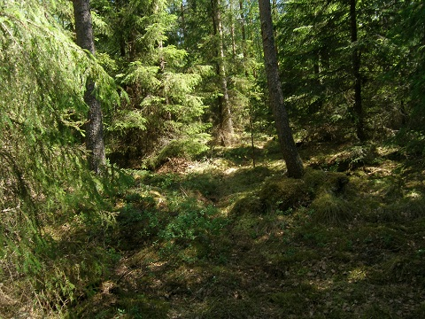
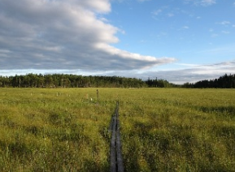
Site scale validation
9 EC sites from Finland & Sweden, 60 N to 68 N
LAI (1-sided) from 0.2 to 6.8 m²m⁻²
Pristine peatland … dense managed forests
Daily ET
dry-canopy conditions
Growing season (May-Oct)
Independent comparison
Model
measured

Slide 8
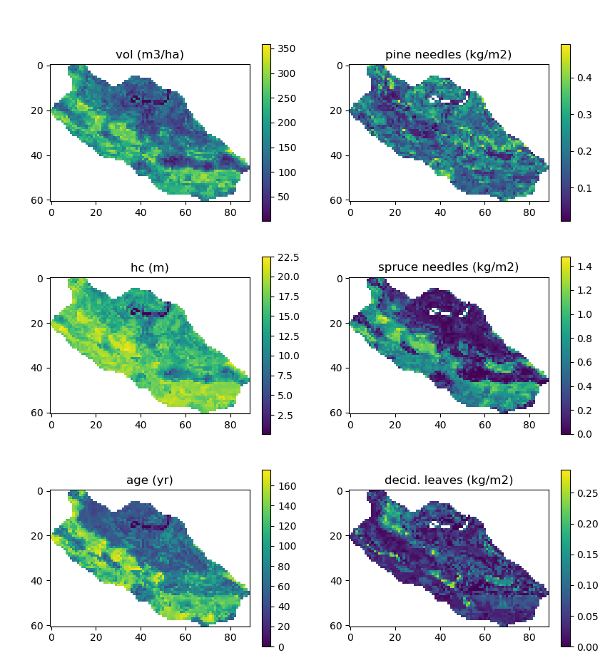
Multi-source National Forest Inventory (16 X 16 m)
45 raster themes (geotiff)
Open data, 3 year update interval
> 80 0000 forest inventory plots
Landsat + DEM, topographic basemap
kNN –interpolation
LAI = M x SLA
Comparison with MODIS LAI: Härkönen et al 2015 Bor. Env. Res. 20: 181–195
1km
1,4km
http://kartta.luke.fi/index-en.html

Slide 9
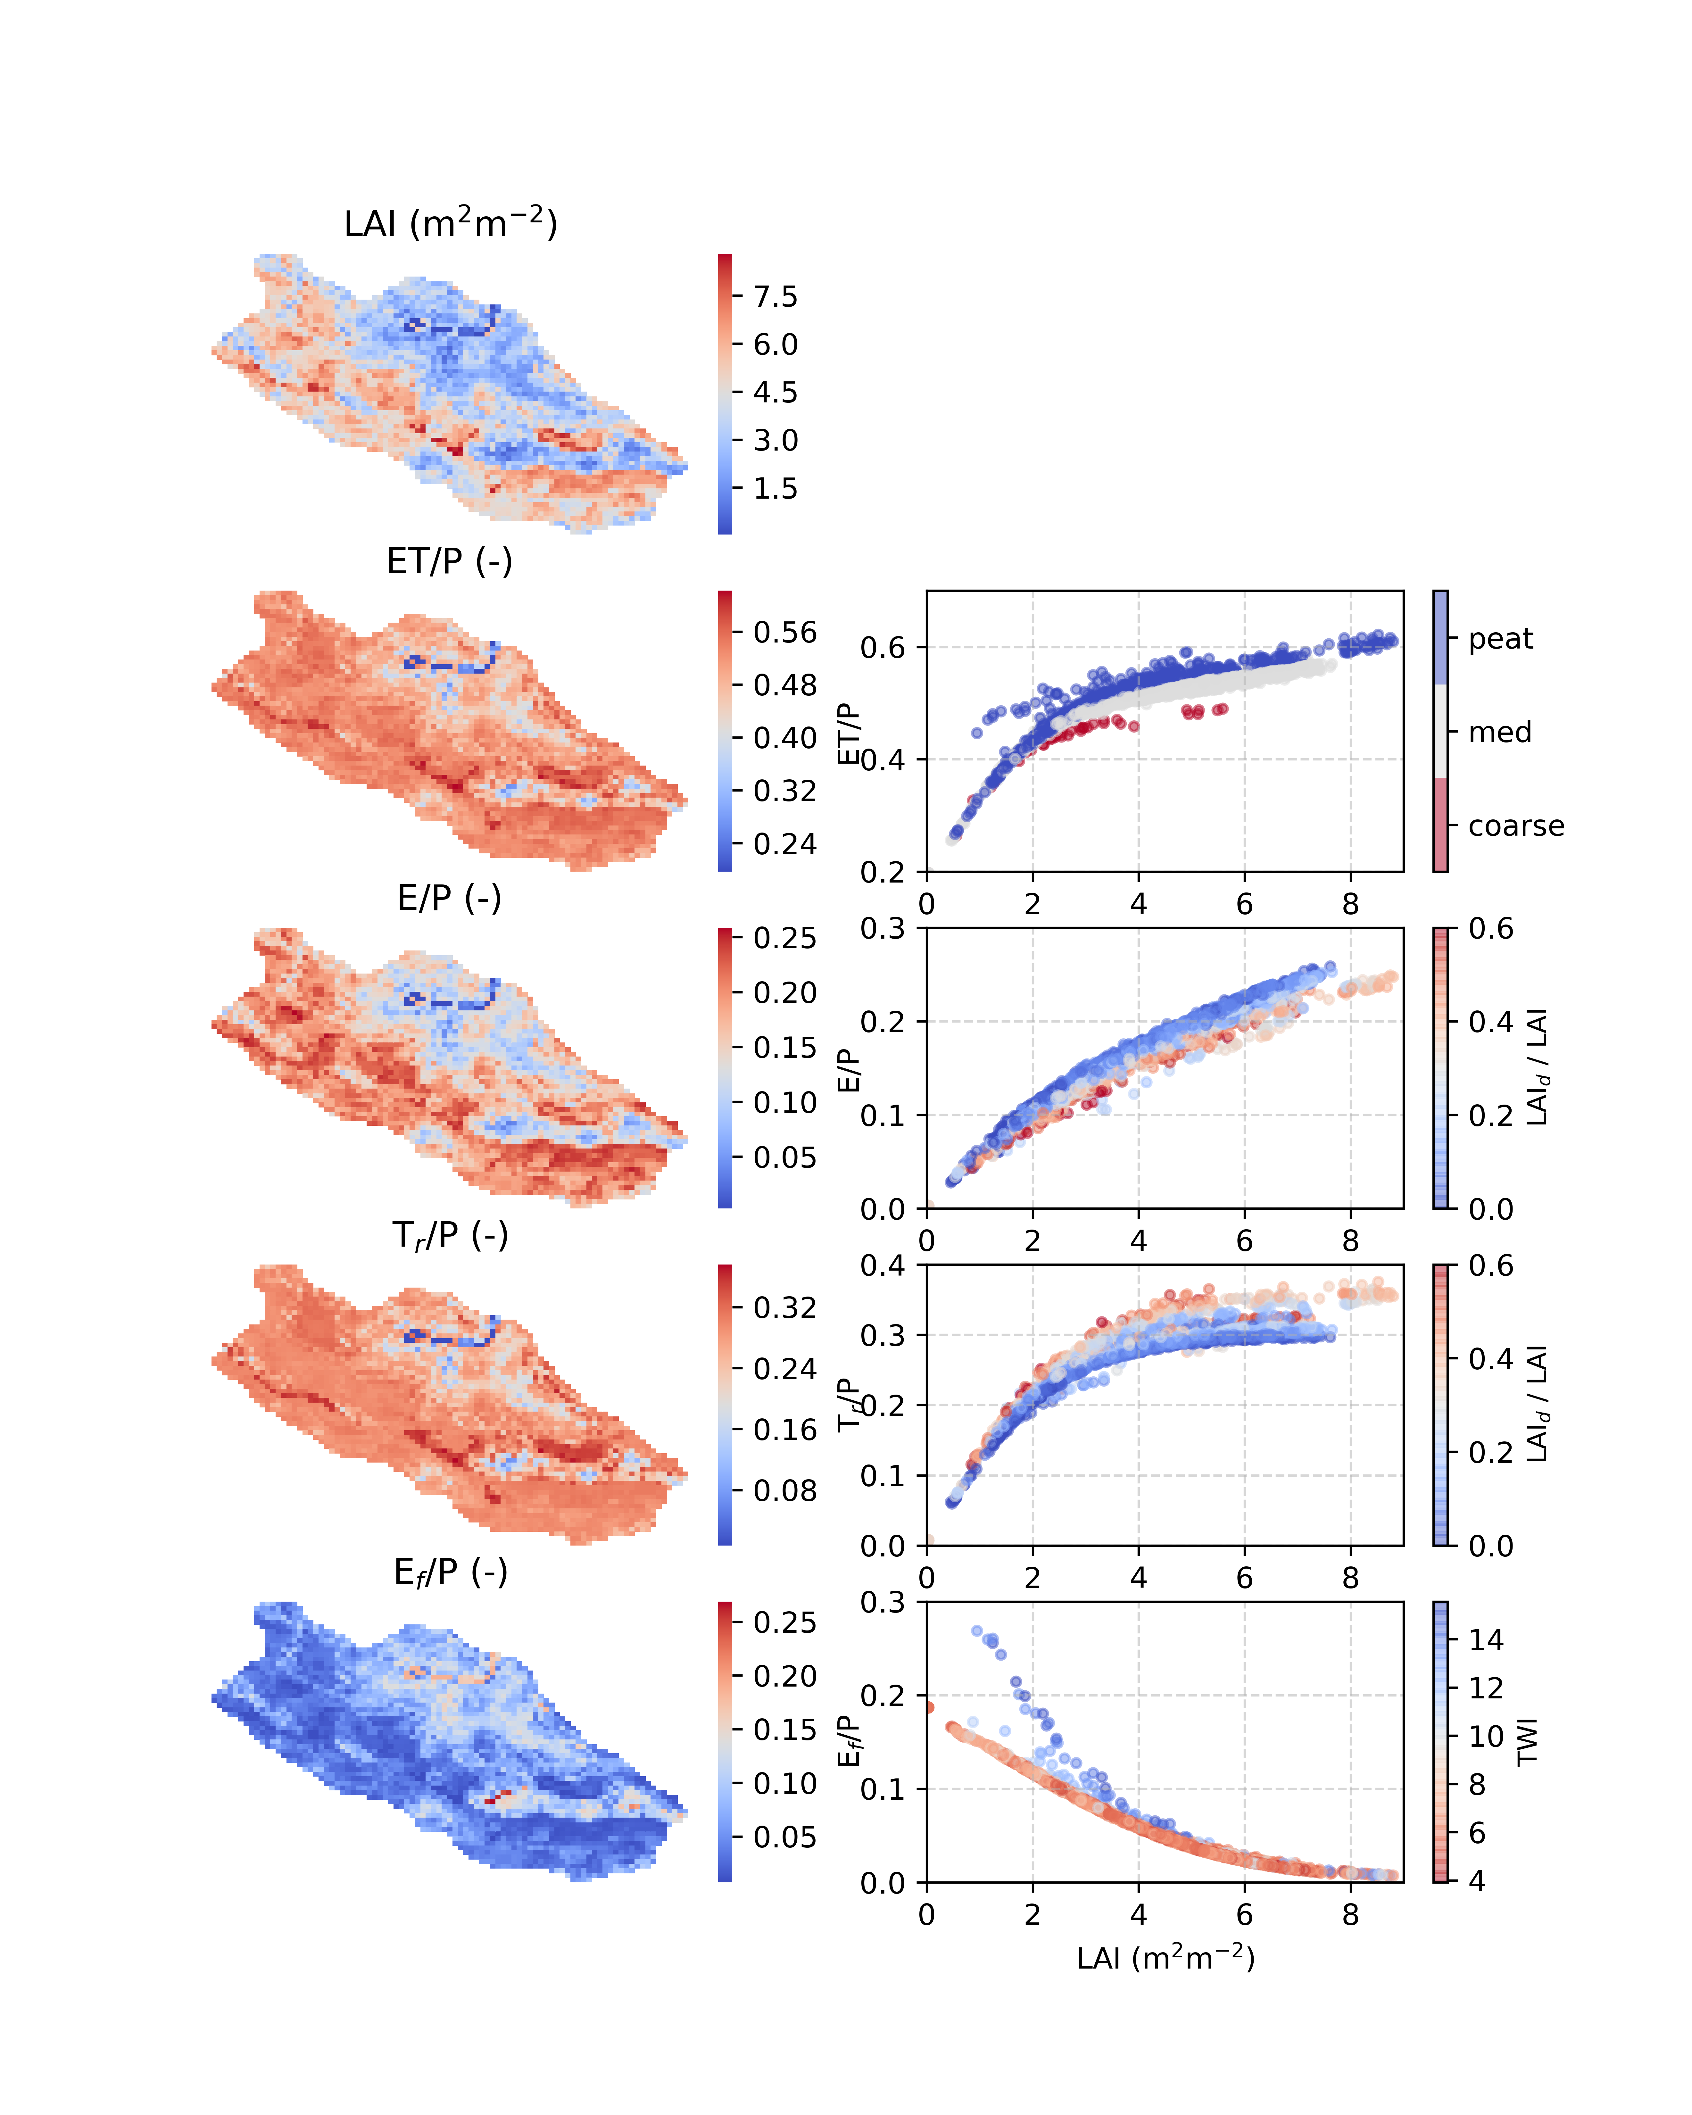
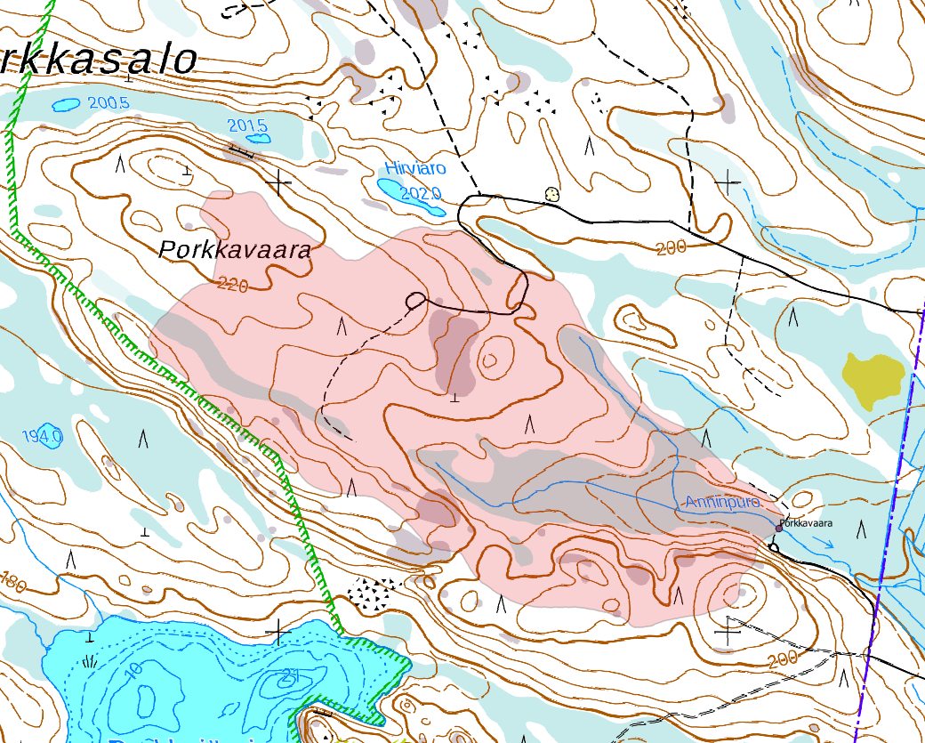
Spatial variability within catchment
Porkkavaara catchment, Eastern Finland, 64ha, 16x16m grid
ET / P
LAI –relationship non-linear; inflection point at LAI 2 to 3 m²m⁻²
Interception
Capacity ~ a x LAI
Snow interception
Transpiration
Saturates due to light limitations
Higher where deciduous dominant
Drought stress at coarse soils
Evaporation from ground
available energy
Gridcells with high TWI receive returnflow & behave as wet surfaces

Slide 10
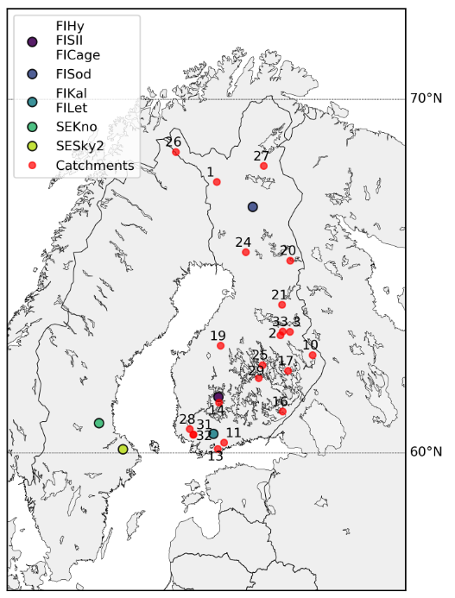
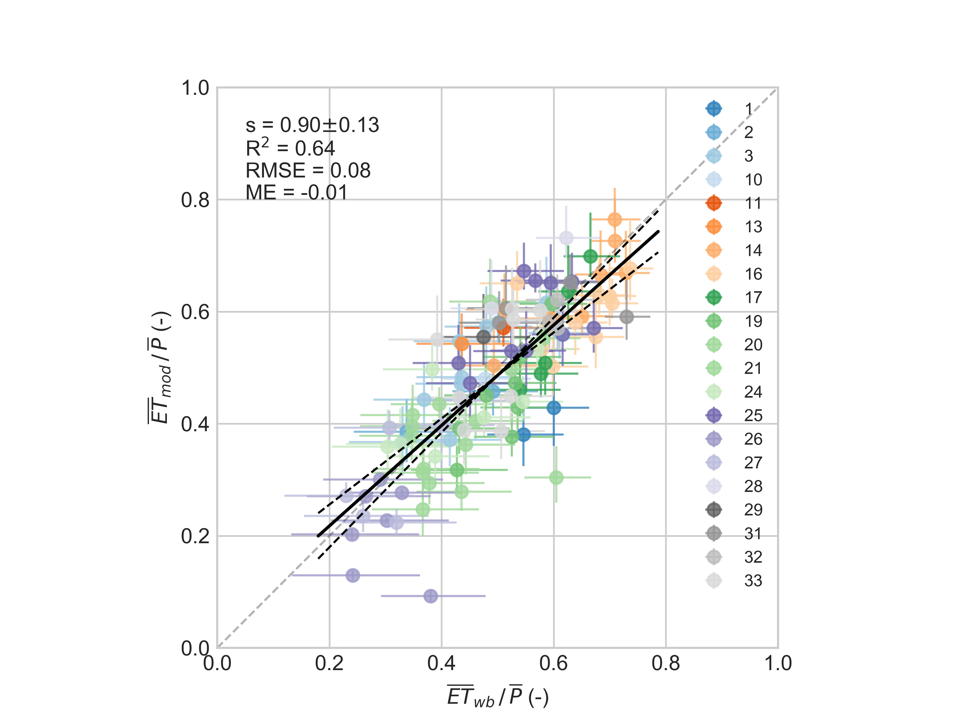
Annual evaporation ratio ET/P
21 headwater catchments over Finland. Streamflow data 1 - 10 yr / catchment
Independent comparison
Across-catchment variability primarily due to north-south gradient:
E_{pot} / P
Length of snow-cover & annual snowfall
LAI
Model + parameter uncertainty
Catchment water balance ET = P – Q

Slide 11
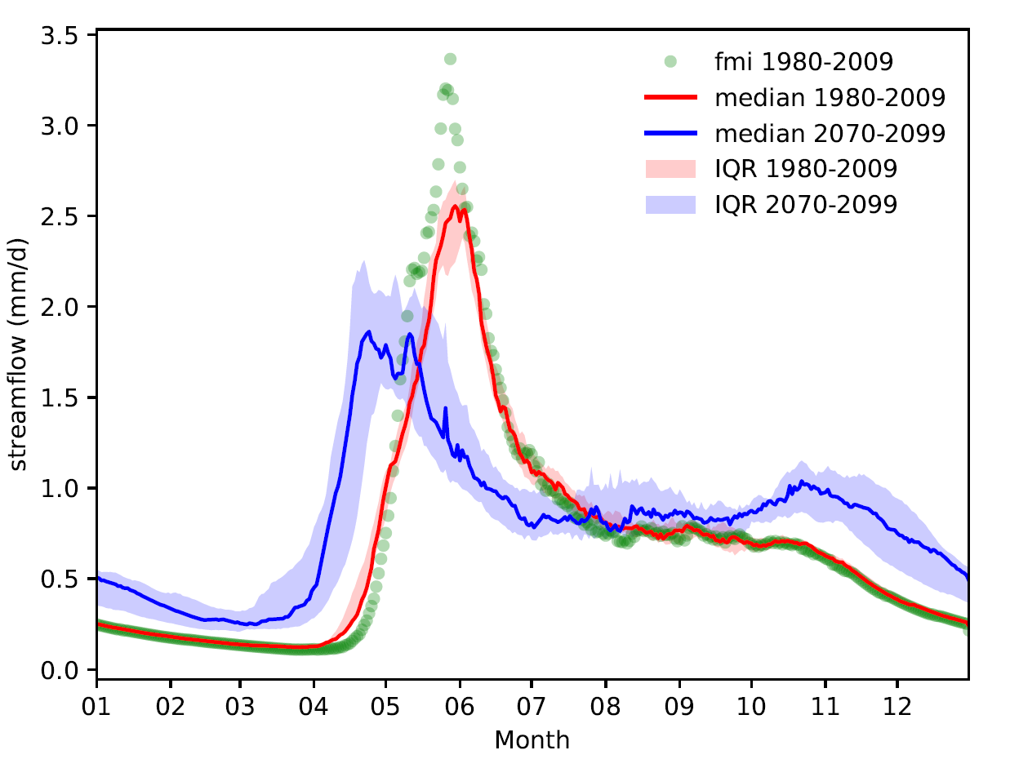
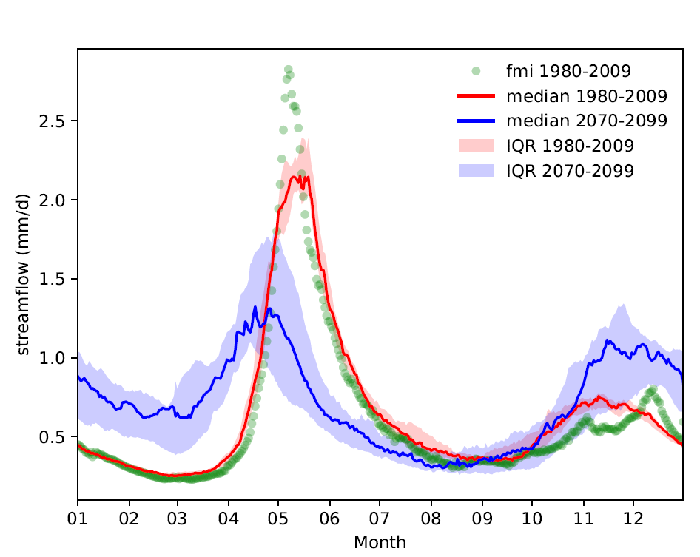
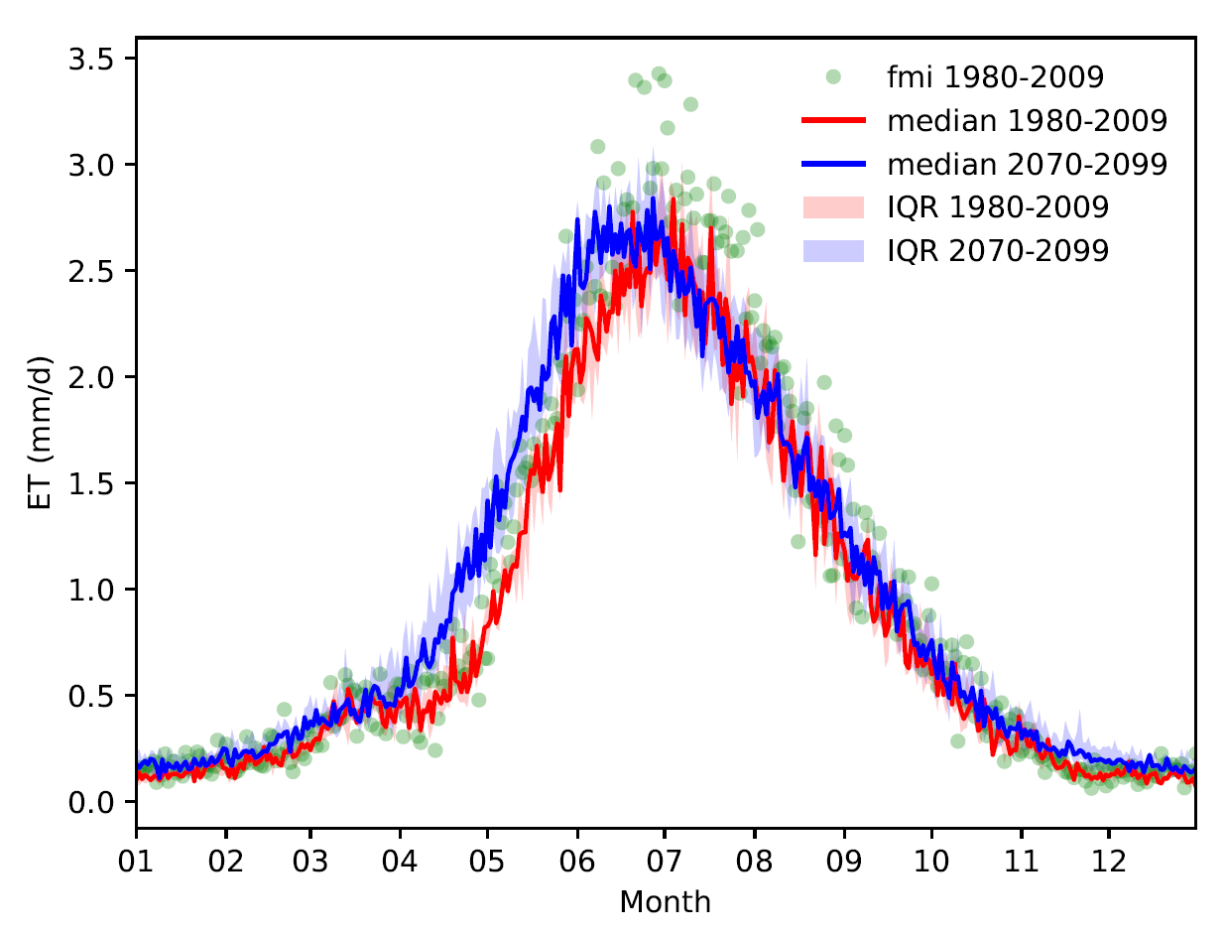
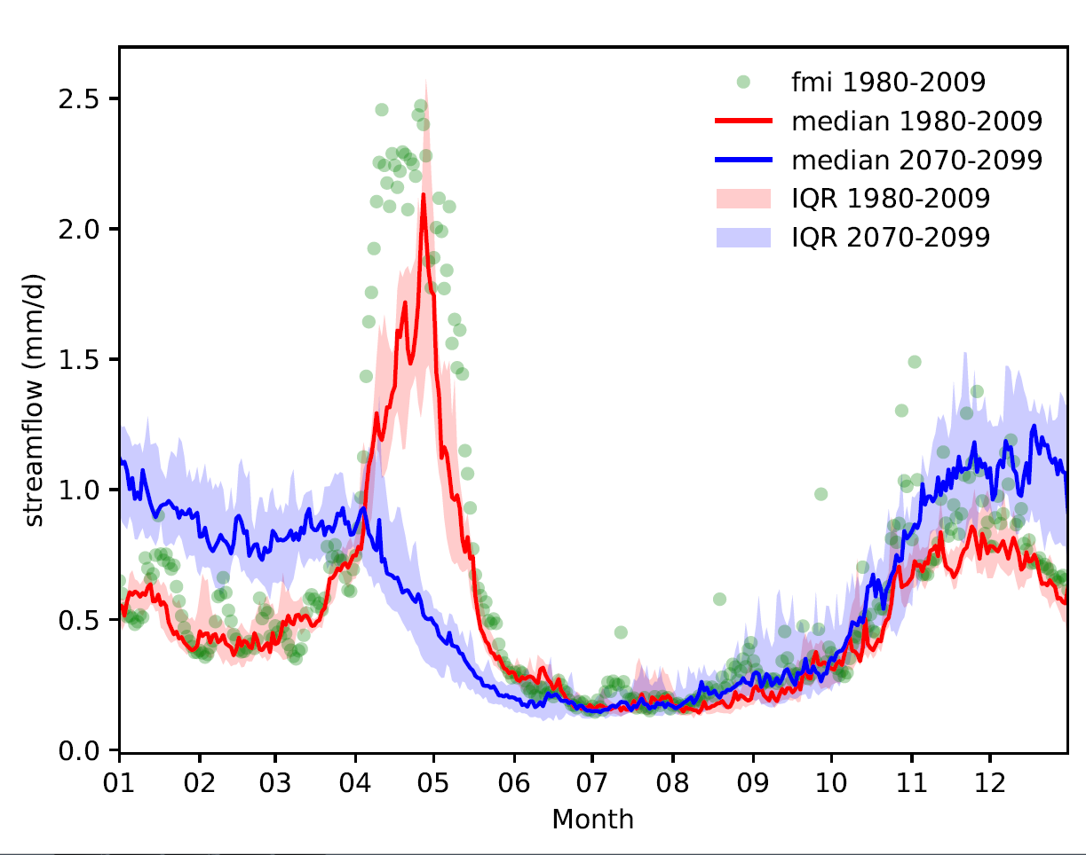
Climate projections
Lompolojängänoja,
Muonio
Porkkavaara,
Sotkamo
Larger evaporative demand
Increasing ground evaporation
Higher wintertime interception
Transpiration:
Increases in spring & early summer
Drought-induced decrease in July-August
Paunulanpuro,
Orivesi

Slide 12


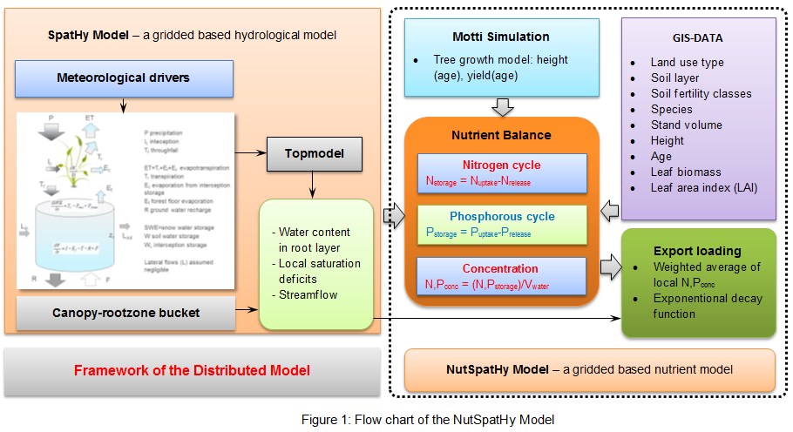
NutSpatHy
A grid-based distributed nutrient model for predicting nitrogen (N) and phosphorous (P) leaching in forested catchments
Model key features:
- Grid-based nutrient balance (Δstorage = release - uptake)
- Nutrient concentration prediction (conc = storage/water_volume)
- Export loading simulation based on SpatHy runoff prediction
- Spatiotemporal modelling of nutrient dynamics
Mingfu Guan
Ari Lauren
FRESHHABIT (2016-2022, EU LIFE+)

Slide 13
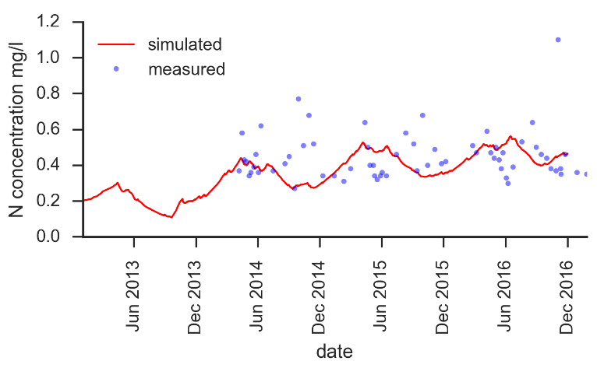
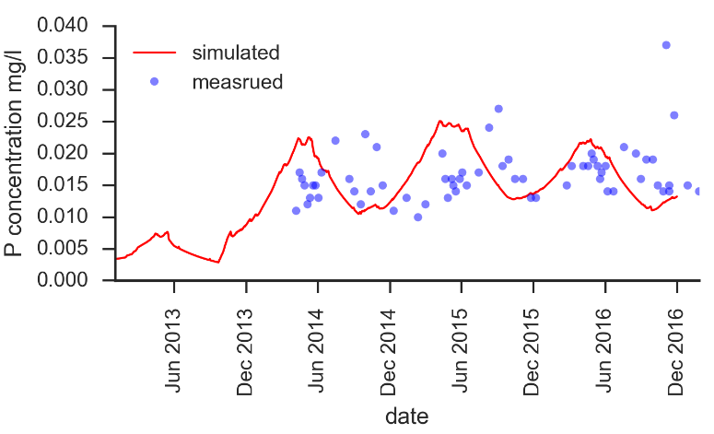
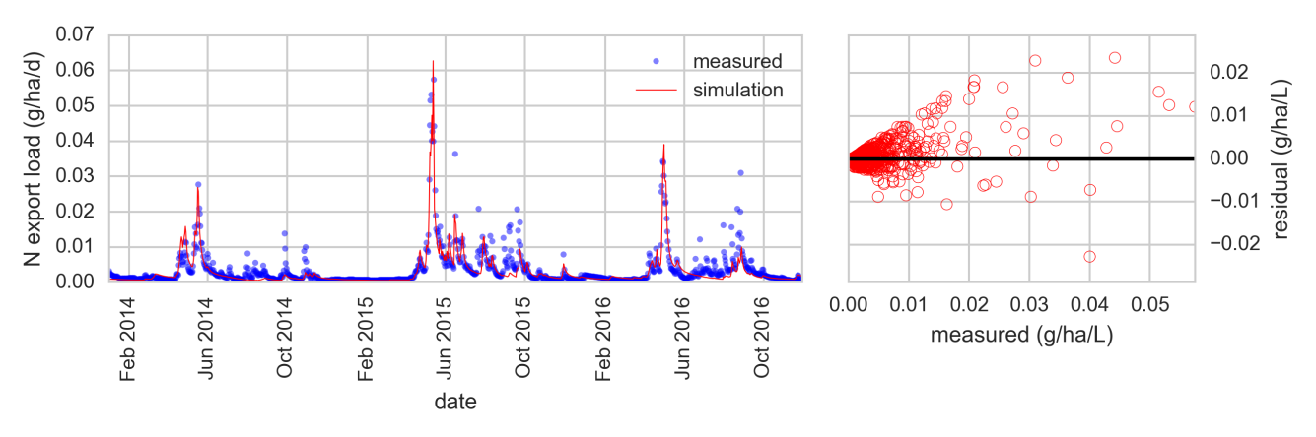
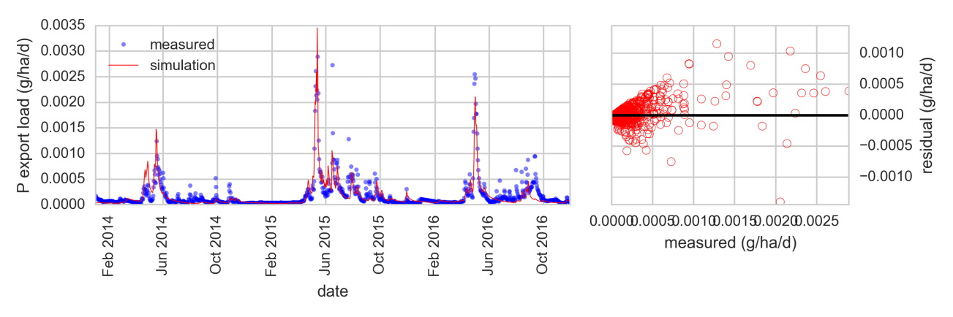
N and P concentration
Nutrient concentration is reasonably predicted considering the complex chemical process and a series of uncertainties of parameters and input data.
Daily and monthly N and P export loading
Good performance in the prediction of export loading verifies the controlling role of hydrology on nutrient transport processes.
Daily N and P export loading: NSC = 0.76, correlation coef.= 0.81
FRESHHABIT (2016-2022, EU LIFE+)
FRESHHABIT (2016-2022, EU LIFE+)

Slide 14

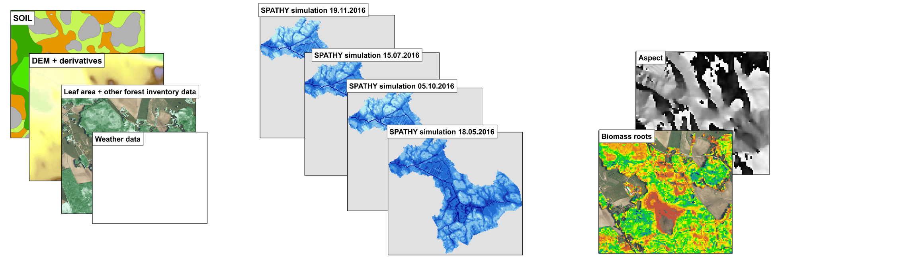
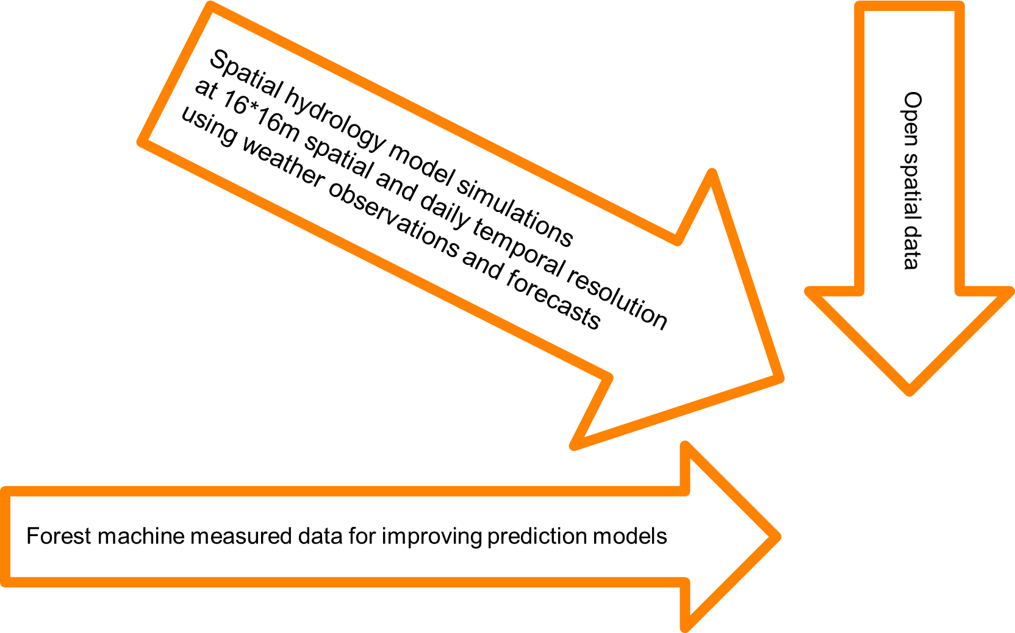
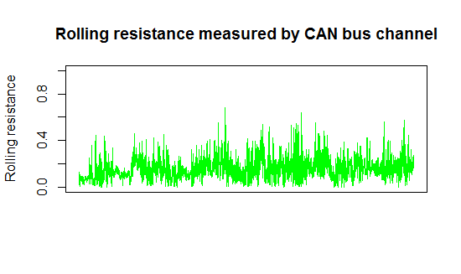
Dynamic forest trafficability prediction by fusion of open data, hydrologic forecasts and harvester-measured data
Aura Salmivaara
Rut depth prediction
f(t, x, y)
Salmivaara, A., Launiainen, S., Ala-Ilomäki, J., Kulju, S., Laurén, A., Sirén, M., Tuominen, S., Finér, L., Uusitalo, J., Nevalainen, P., Pahikkala, T., and Heikkonen, J. 2017. Dynamic forest trafficability prediction by fusion of open data, hydrologic forecasts and harvester-measured data. Poster.

Slide 15
Take home!
Daily forest ET can be predicted with simple scheme with no site / catchment-specific calibration
A three-source model seems as a good compromise
Lot of things going on:
Forest trafficability
Towards spatial biogeochemistry
Radiation heterogeneity by topography & surrounding canopies
What can be done at one point should be done spatially
Codes (Python 2.7/3.x)

Slide 16
contact: samuli.launiainen@luke.fi
Presentation available at:
https://github.com/LukeEcomod/EGU2018

